Slide 1

Cache Controller Implementation With Write-Through Policy
By: - Ahmed Mahmoud Hoseiny
- Kareem Elsaeed Abdel Hafez

Slide 2
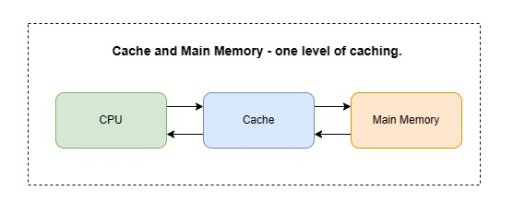
Specifications
One level of caching between the CPU and main memory.

Slide 3
Specifications
The main memory module:
It has a capacity of 4 Kbytes (word addressable using 10 bits).
It is accessed (for read) takes 4 clock cycles and (for write) takes 1 cycle.
The cache array module:
The total cache capacity is 512 bytes.
That each cache block is 16 bytes.
The cache has 32 blocks in total.
The cache uses direct mapping.

Slide 4
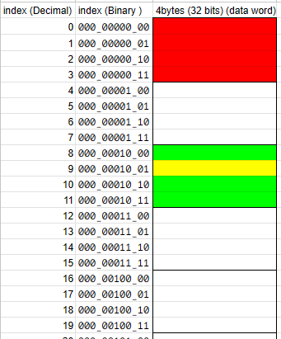

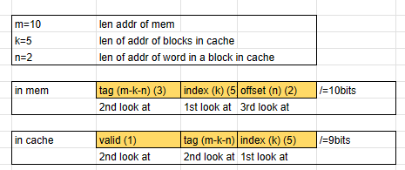

Slide 5
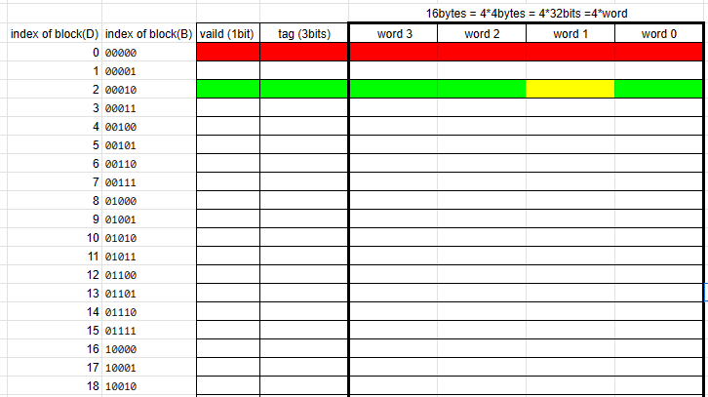

Slide 6
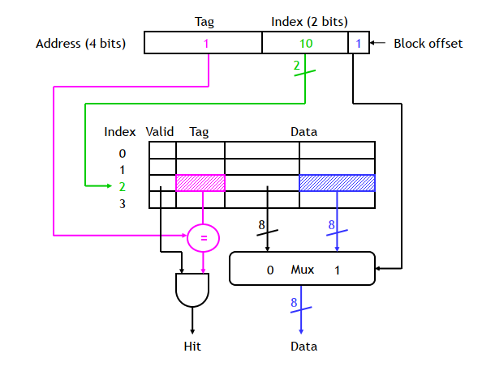

Slide 7
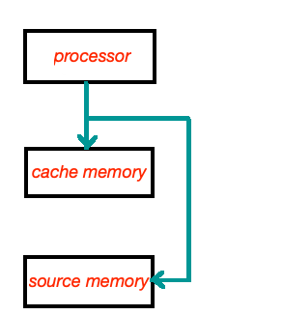
Specifications
The cache uses write-through for write-hit and write-around policies for write-miss.
Write-through
Write-around

Slide 8
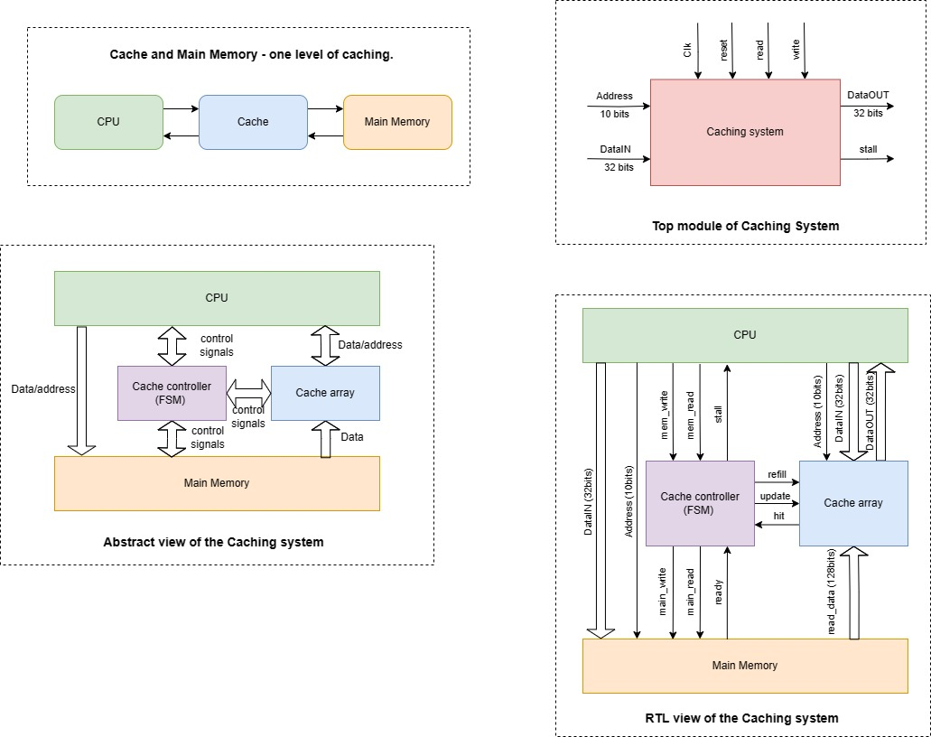
RTL Schematic

Slide 9
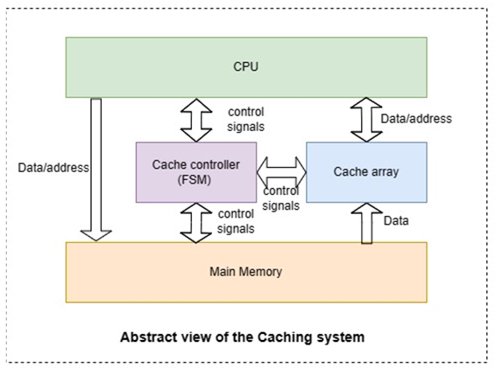
RTL Schematic

Slide 11
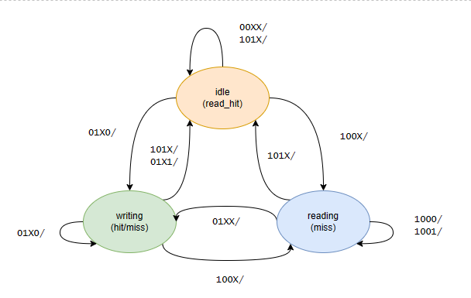
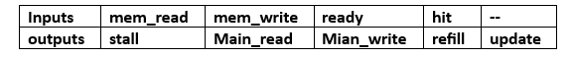
The State Diagram of The FSM

Slide 12
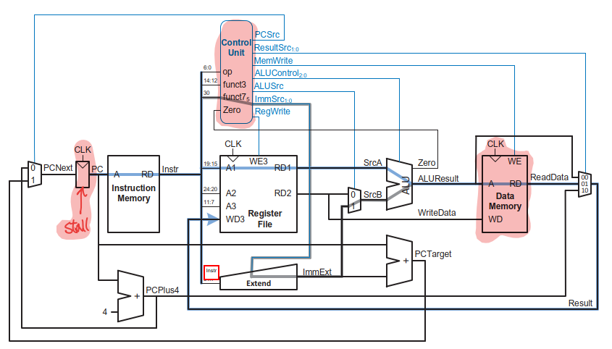
The modifications of RISC_V

Slide 13
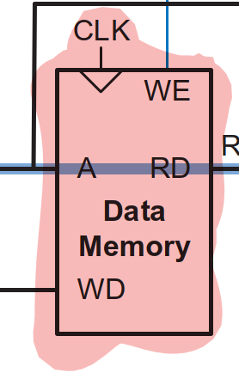
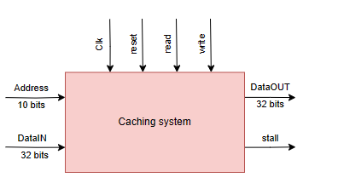
The modifications of RISC_V

Slide 14
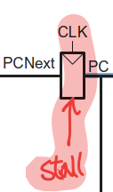
The modifications of RISC_V

Slide 15
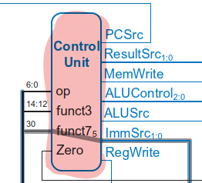
The modifications of RISC_V
MemRead

Slide 16
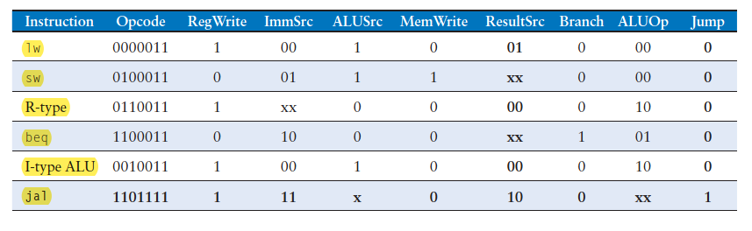
The modifications of RISC_V
MemRead
1
0
0
0
0
0

Slide 17
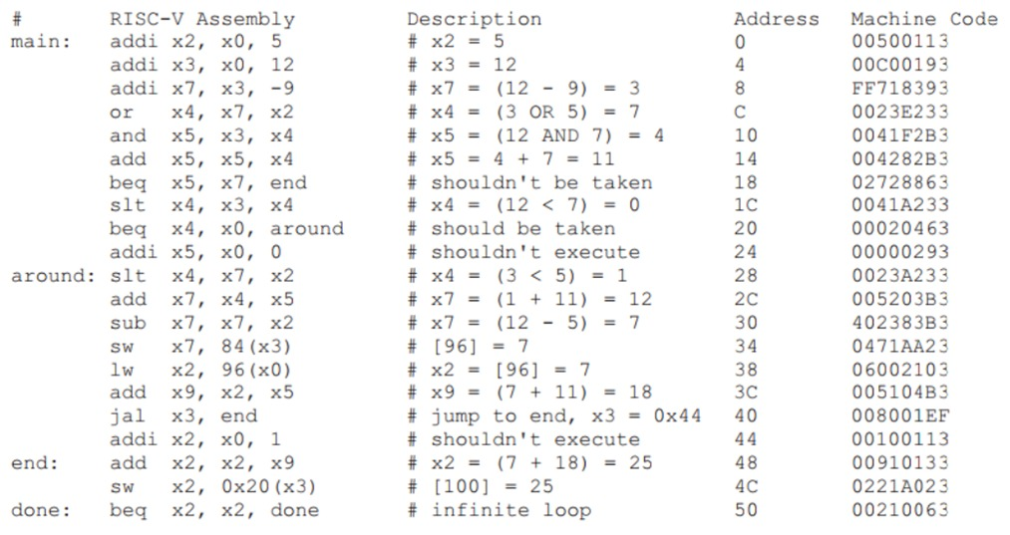
Test Program for RISC_V

Slide 18
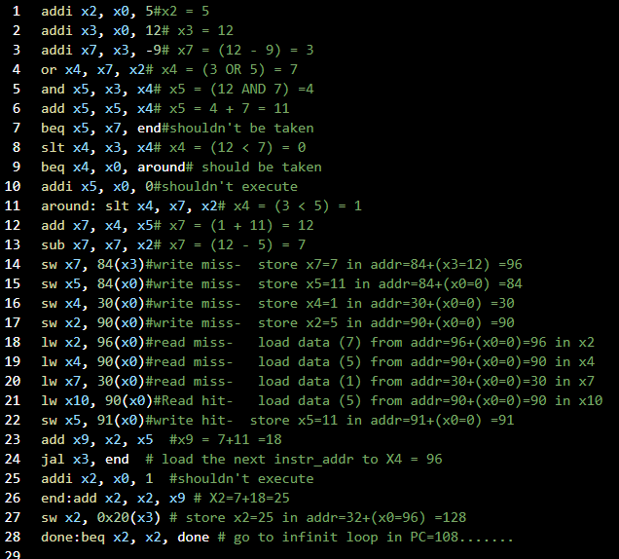
Test Program for RISC_V

Slide 19
Test Program for RISC_V (Cont..)

Slide 20
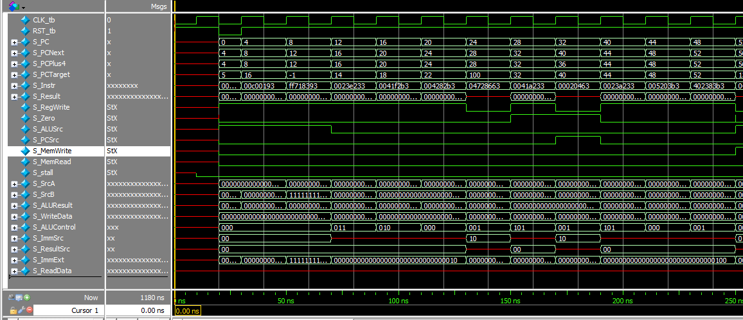
Waveforms (1)

Slide 21
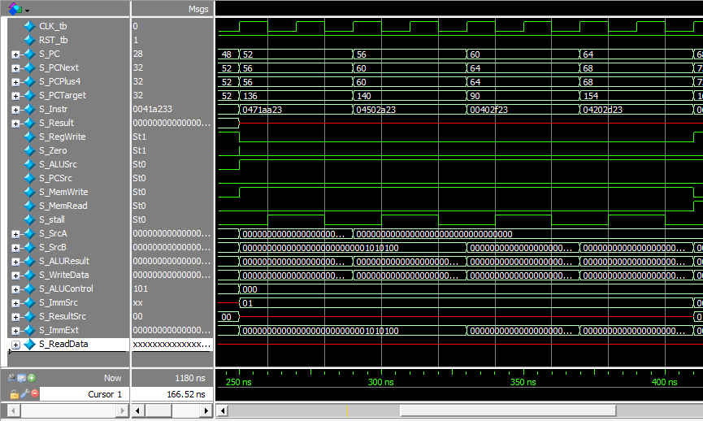
Waveforms (2) write miss

Slide 22
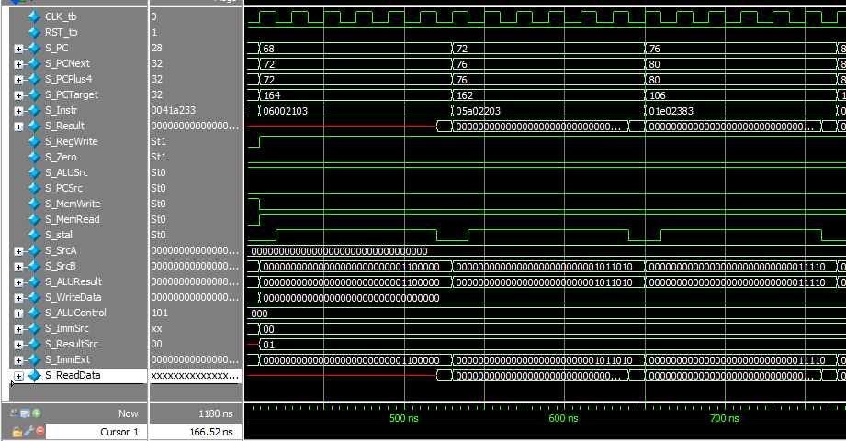
Waveforms (3) read miss

Slide 23
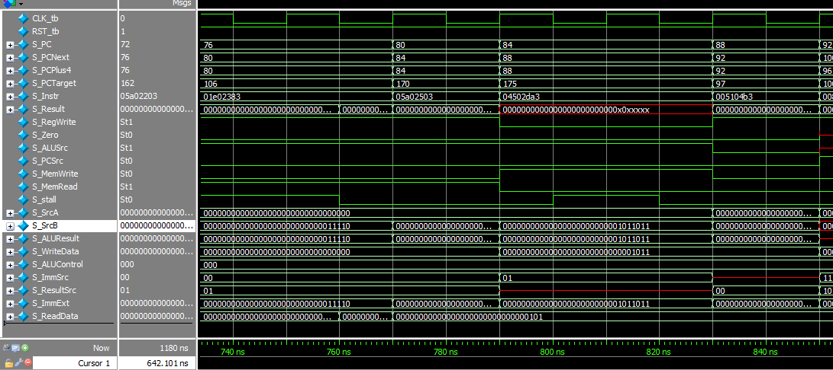
Waveforms (3) read hit

Slide 24
Waveforms (3) write hit

Slide 25
Hit and Miss Latencies
Action | Latency (clock cycles) | Stall (clock cycles)
Read Hit | 1 | -
Read Miss | 6 | 5
Write Hit | 2 | 1
Write Miss | 2 | 1
Notes:
Handling Read Hits and Misses
All Read Hits are straight forward. No stalling on the processor for Read Hits. However, Read Misses stall the processor so as to fetch the requested data block from the Main Memory in the meantime. Fetching of the data block is followed by updating the Cache Line and then finally followed by a Read Hit to complete the read cycle. Read Miss has the most expensive penalty in the design.
Handling Write Hits and Misses
All Write Hits/Misses stall the processor for the same number of cycles. Hence, they are equivalent in the amount of penalty. This is because of the Write-Through Policy in the design that forces writing to the Main Memory on all Write Hits for Data Coherence/Consistency between the Main Memory and the Cache. Write-Around Policy is followed on Write Misses. The misses write the data directly to the Main Memory, without loading the data block to the Cache

Slide 26
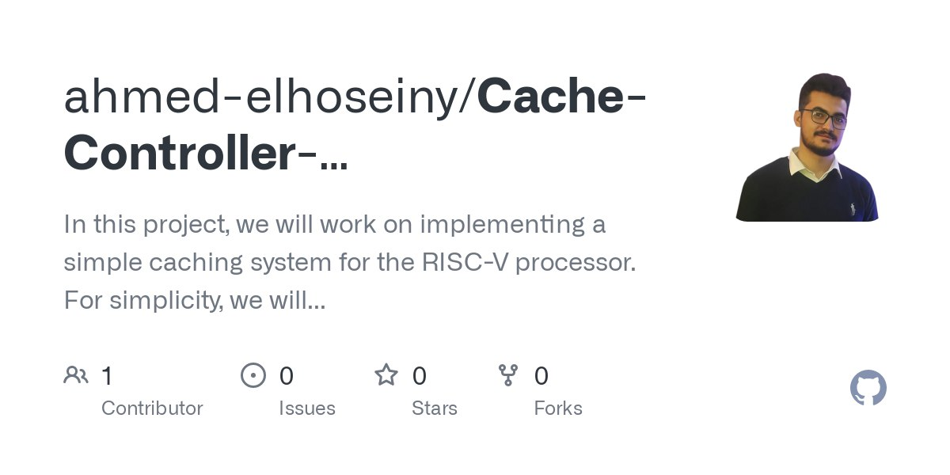

GITHUB REPOSITORY

Slide 27
Thank you

